Slide 1

Application Layer (HTTP)
Lecture 3 | Part 1 of 2 | CSE421 – Computer Networks
Department of Computer Science and Engineering School of Data & Science

Slide 2
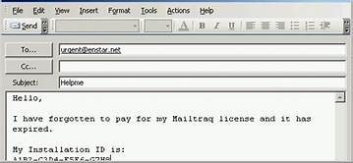

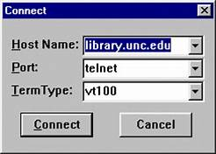
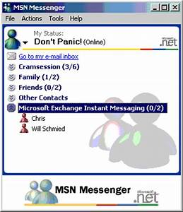



Applications
1970-1980
1990-2000
2000-2020

Slide 3

Objectives (Application Layer)
Principles of network applications
Web and HTTP
Electronic Mail (SMTP, POP3, IMAP)
DNS
P2P Applications
Video streaming and content distribution networks
Socket Programming with UDP and TCP

Slide 4
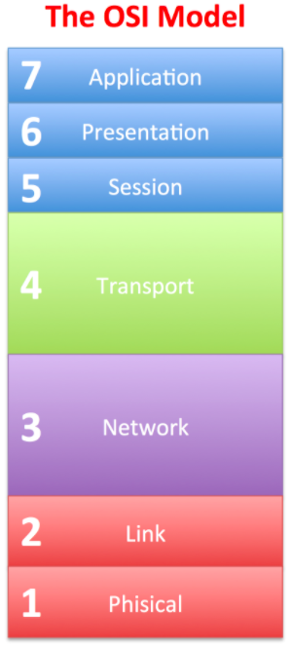
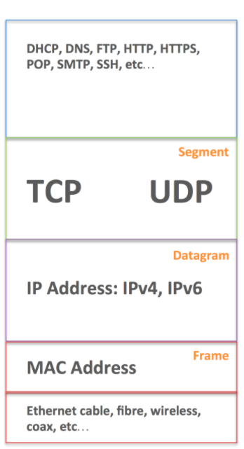
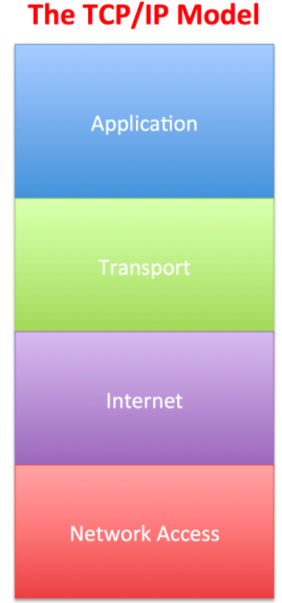
Network Models
Data
Port Numbers
Data Link
Physical

Slide 5
Application Layer
Application Layer Protocols
Provide the rules and formats that govern how data is treated in the application layer.
Application Software
The programs used to communicate over the network.
For example:
When displaying a web page:
The Application Layer uses the HTTP(Hyper Text Transfer Protocol) Protocol.
The Application Software is your Web browser.

Slide 6
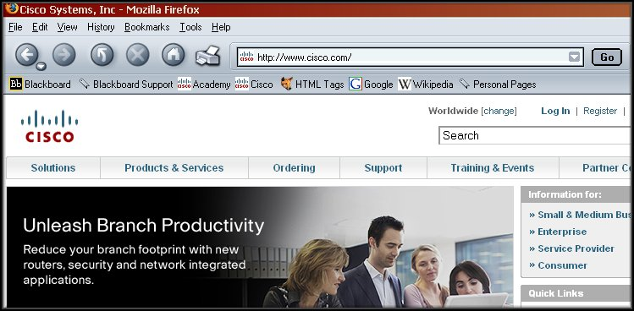
Application Layer

Slide 7
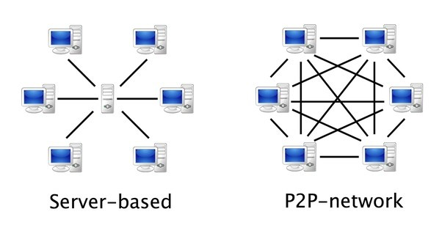
Application Layer
When accessing information on a device, the data may not be physically stored on that device.
If that is the case, a request must be made to the device where the data resides.
Two methods:
Client/Server
Peer-to-Peer (P2P)
Client-Server
Peer-to-Peer(P2P)

Slide 8
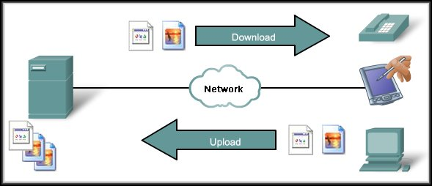
Client/Server Model
May also require control information. User Authentication or identify a file to be transferred.
Clients – hardware, software combination
Files downloaded to the client.
The client begins the exchange by making a request for data.
The server responds with one or more streams of data.
Files uploaded to the server
Resources are stored on the server.

Slide 9
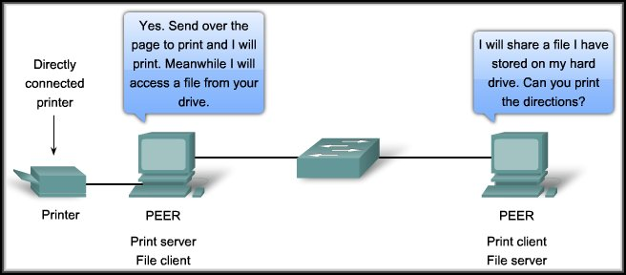
Peer-to-Peer Model
Two or more computers are connected via a network and can share resources (such as printers and files) without having a dedicated server.
End devices (peers) can function as either a server or client depending upon the required service.
Notes:
Every connected end device (known as a peer) can function as either a server or a client.
Peer-to-peer networks decentralize the resources on a network without using a centralized server.
One computer might assume the role of server for one transaction while simultaneously serving as a client for another. The roles of client and server are set on a per request basis.

Slide 10
Web and HTTP

Slide 11
Objectives (HTTP-Part 1)
WWW – The Web
HTTP
HTTP Connections
Persistent HTTP Connections
Non Persistent HTTP Connections

Slide 12

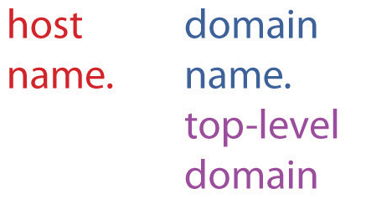
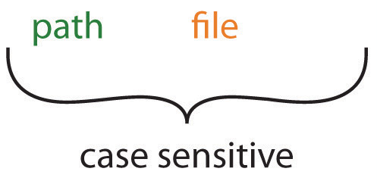
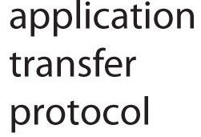
WWW- The Web
Web page consists of objects
Object can be HTML file, JPEG image, Java applet, audio file,…
Web page consists of base HTML-file which includes several referenced objects
Each object is addressable by a URL Uniform Resource Locater, e.g.,

Slide 13

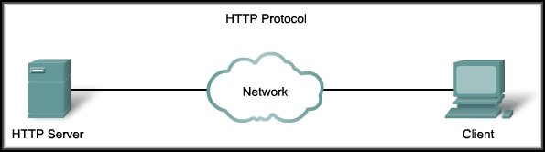
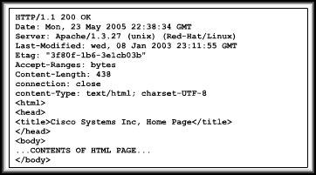

HTTP
HTTP Protocol
HTTP request
Web Server
HTTP response
Web Browser
Web browsers are the client applications used to interpret the HTTP application protocol received from a web server.

Slide 14

HTTP Connections
Suppose user enters URL:
(contains text,
references to 10
jpeg images)
www.someSchool.edu/someDepartment/home.index
1a. HTTP client initiates TCP connection to HTTP server (process) at www.someSchool.edu on port 80
1b. HTTP server at host www.someSchool.edu waiting for TCP connection at port 80. “accepts” connection, notifying client
2. HTTP client sends HTTP request message (containing URL) into TCP connection socket. Message indicates that client wants object someDepartment/home.index
3. HTTP server receives request message, forms response message containing requested object, and sends message into its socket
time

Slide 15
HTTP Connections (cont.)
4. HTTP server closes TCP connection.
5. HTTP client receives response message containing html file, displays html. Parsing html file, finds 10 referenced jpeg objects
6. Steps 1-5 repeated for each of 10 jpeg objects
time
Non-persistent HTTP

Slide 16
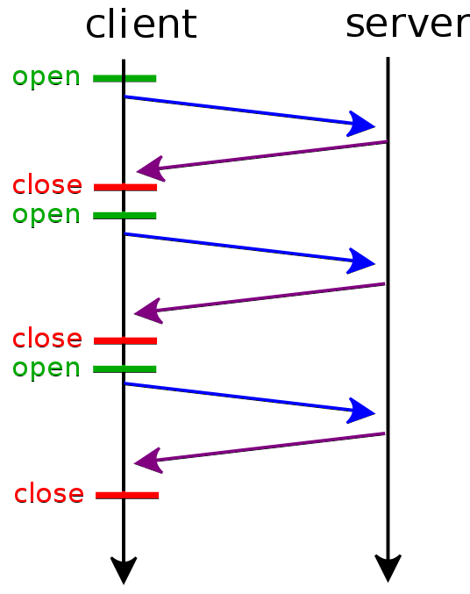

HTTP connections
Non-persistent HTTP
At most one object sent over TCP connection
Connection is then closed
Downloading multiple objects required multiple connections
open ---–TCP Connection Request
close ---– TCP Termination Request

Slide 17
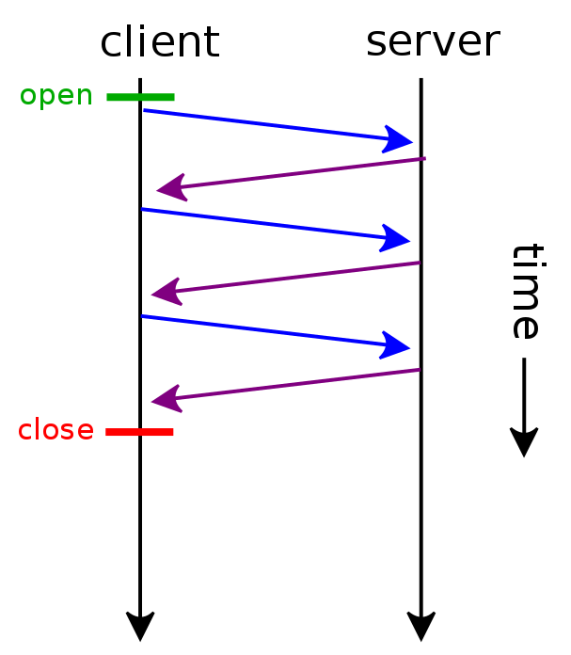
HTTP connections
Persistent HTTP
Multiple objects can be sent over single TCP connection between client, server
open ---–TCP Connection Request
close ---– TCP Termination Request

Slide 18
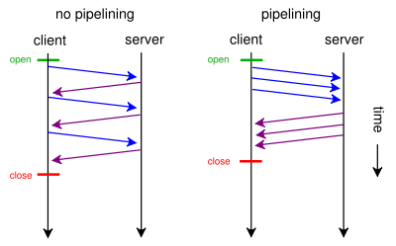
HTTP connections

Slide 19
Non-persistent HTTP: response time
RTT (Round Trip Time): time for a small packet to travel from client to server and back
HTTP response time:
One RTT to initiate TCP connection
One RTT for HTTP request and first few bytes of HTTP response to return
File transmission time
Non-persistent HTTP response time =
2*RTT+ file transmission time
Initiate TCP
connection
RTT
Request
file
RTT
Time to
transmit
file
File
received
time
time

Slide 20
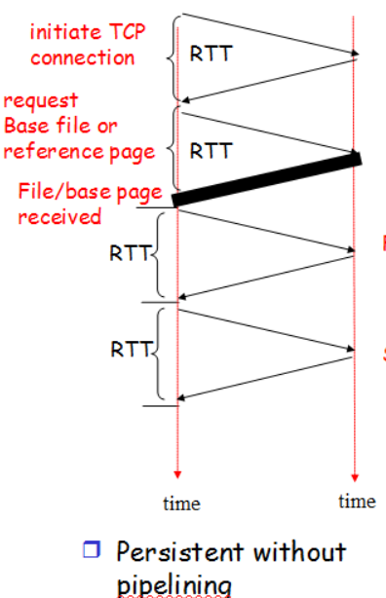
Persistent HTTP
Non-persistent HTTP issues:
Requires 2 RTTs per object
OS overhead for each TCP connection
Browsers often open parallel TCP connections to fetch referenced objects
Persistent HTTP:
Server leaves connection open after sending response
Subsequent HTTP messages between same client/server sent over open connection
Client sends requests as soon as it encounters a referenced object
As little as one RTT for all the referenced objects
2nd object
3rd object

Slide 21
Objectives – Part 3
HTTP Message Formats
HTTP Request Message
HTTP Methods
HTTP Response Message

Slide 22
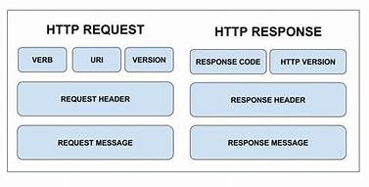
HTTP messages
Two types of HTTP messages:
Request and Response

Slide 23
HTTP request message
HTTP request message:
ASCII (human-readable format)
carriage return character
line-feed character
request line
(GET, POST,
HEAD,PUT,DELETE
commands)
GET /somedir/index.html HTTP/1.1\r\n
Host: www.someschool.edu\r\n
User-Agent: Firefox/3.6.10\r\n
Accept: text/html,image/gif, image jpeg\r\n
Accept-Language: fr \r\n
Connection: close\r\n
\r\n
header
lines
carriage return,
line feed at start
of line indicates
end of header lines
* Check out the online interactive exercises for more examples: http://gaia.cs.umass.edu/kurose_ross/interactive/

Slide 24
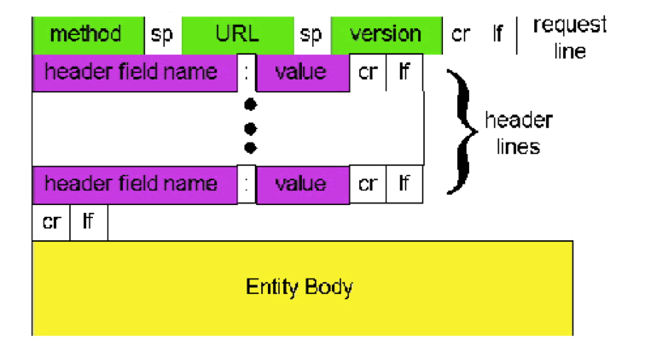
HTTP request message: General Format
GET //somedir/index.html HTTP/1.1\r\n
Host: www.someschool.edu\r\n
User-Agent: Firefox/3.6.10\r\n
Accept: text/html,image/gif, image jpeg\r\n
Accept-Language: fr \r\n
Connection: close\r\n
\r\n

Slide 25
Uploading form input
POST method:
Web page often includes form input
Input is uploaded to server in entity body
URL method:
Uses GET method
Input is uploaded in URL field of request line:
www.somesite.com/animalsearch?monkeys&banana

Slide 26
Method types
HTTP/1.1:
GET, POST, HEAD
PUT
Uploads file in entity body to path specified in URL field
Replaces existing objects
DELETE
Deletes file specified in the URL field
HTTP/1.0:
GET
Primarily gets information only
URL Method of data insertion
POST
Creating new data
HEAD
Asks server to leave requested object out of response

Slide 27
HTTP response message
Status line
(protocol
status code
status phrase)
HTTP/1.1 200 OK\r\n
Date: Sun, 26 Sep 2010 20:09:20 GMT\r\n
Server: Apache/2.0.52 (CentOS)\r\n
Last-Modified: Tue, 30 Oct 2007 17:00:02 GMT\r\n
ETag: "17dc6-a5c-bf716880"\r\n
Accept-Ranges: bytes\r\n
Content-Length: 2652\r\n
Keep-Alive: timeout=10, max=100\r\n
Connection: close\r\n
Content-Type: text/html; charset=ISO-8859-1\r\n
\r\n
data data data data data ...
Header
lines
data, e.g.,
requested
HTML file
* Check out the online interactive exercises for more examples: http://gaia.cs.umass.edu/kurose_ross/interactive/

Slide 28
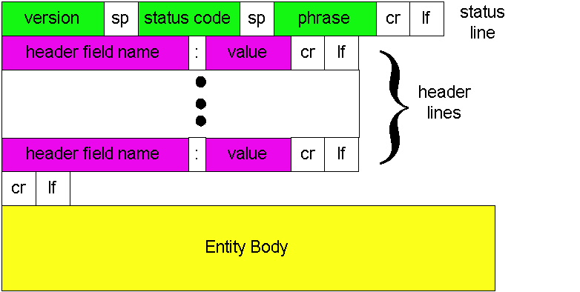
HTTP response message: General Format

Slide 29
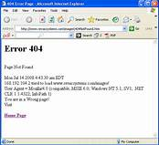
HTTP response status codes
Status code appears in 1st line in server-to-client response message.
Some sample codes:
200 OK
request succeeded, requested object later in this message
301 Moved Permanently
requested object moved, new location specified later in this message (Location:)
400 Bad Request
request message not understood by server
404 Not Found
requested document not found on this server
505 HTTP Version Not Supported

